Slide 1






WP 5 - Virtual Neutron and X-ray Laboratory
Juncheng E*, Carsten Fortmann-Grote, Mads Bertelsen, Aljosa Hafner, Mousumi Upadhyay Kahaly, Zsolt Lecz
The 1st Annual Meeting of PaNOSC
Trieste, Nov. 4, 2019
* juncheng.e@xfel.eu

Slide 2
Participants in WP5
EuXFEL: Carsten Fortmann-Grote, Juncheng E (Jun), [Adrian P. Mancuso]
ESS: Mads Bertelsen, [Thomas H. Rod]
CERIC-ERIC: Aljosa Hafner
ELI-HU: Mousumi Upadhyay Kahaly, Zsolt Lecz
ESRF: [Andy Gotz]

Slide 3




WP5 Virtual Neutron and X-ray Laboratory
Virtual Neutron and x-raY Laboratory (ViNYL) is a simulation environment to:
Offer services for simulation and modelling of photon and neutron instruments, as well as start-to-end simulations to describe entire experiments at photon and neutron facilities.
Make simulation data services inter-operable among partners and with data analysis services and data catalogs.
Enable research infrastructures to seamlessly link this experiment simulation services to their in-house data reduction, analysis, and visualization infrastructures.

Slide 4
Why do we need simulation services for research infrastructures?
Experimental design and optimization
Estimation of experimental artifacts
Supporting material for beamtime proposals
Assisting in decision making during an ongoing experiment
Interpretation of experimental data (with WP4)
Teach students and new users to familiarize with the experiment (with WP8)

Slide 5
Road map
“High–level” application programming interfaces to the “low–level” simulation codes.
Metadata standards for simulation data.
Documented usage examples in both web based and desktop based user interfaces.
Build a cloud service based on all above.

Slide 6
Road map
Simulation Platform
Jupyter Hub
Remote Desktop
API Layer
SimEx
McStas
OASYS
Computing Resources
Source and Beamline Simulation
Sample Trajectory Simulation
Simulation of Scattered Intensity
Data formats,
metadata standards,
FAIR principles
Photon/
Neutron database
Sample
Trajectory
Sim. Data
Catalog
Exp. Data
Catalog
Data Reduction and Analysis (WP4)

Slide 7
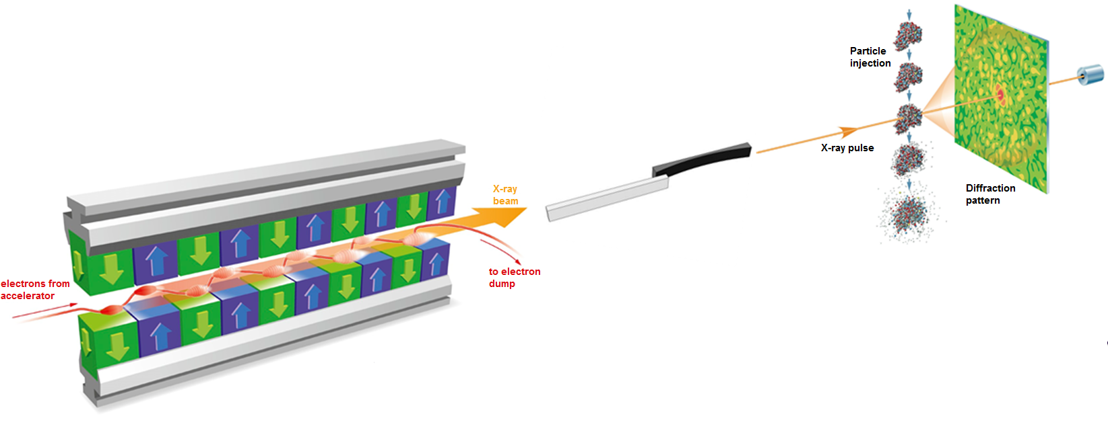

SimEx enables users and facility operators to simulate experiments “from source to detector” at advanced light sources.
Signal generation
Spectroscopy
Diffraction
Inelastic scattering
Detector response
Pixel detectors
Photon Source
XFEL
Synchrotron
Optical Laser
Photon propagation
Fully coherent
Raytracing
Hybrid
Yoon et al. Scientific Reports 6 24791 (2016)

Slide 8
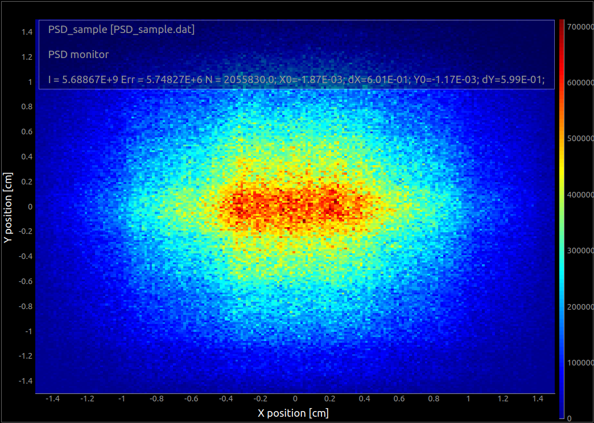
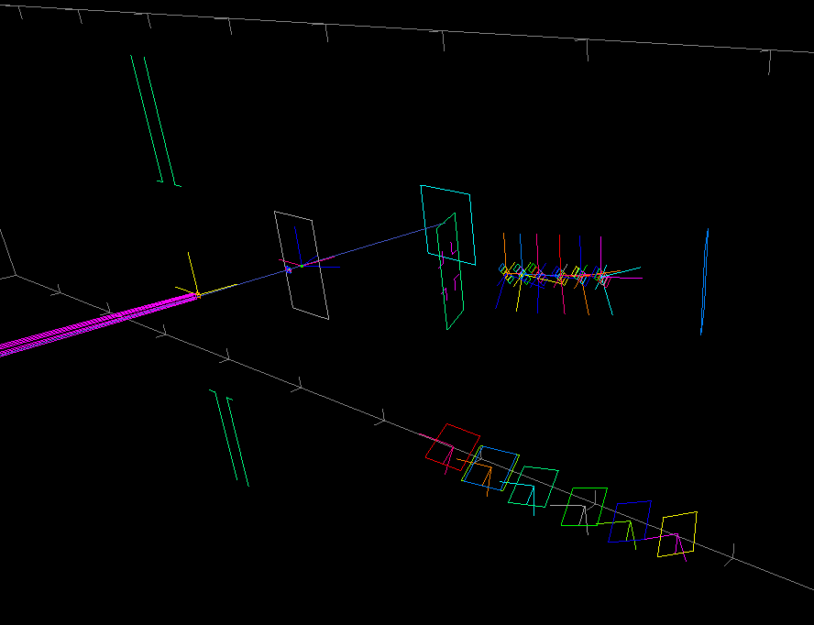

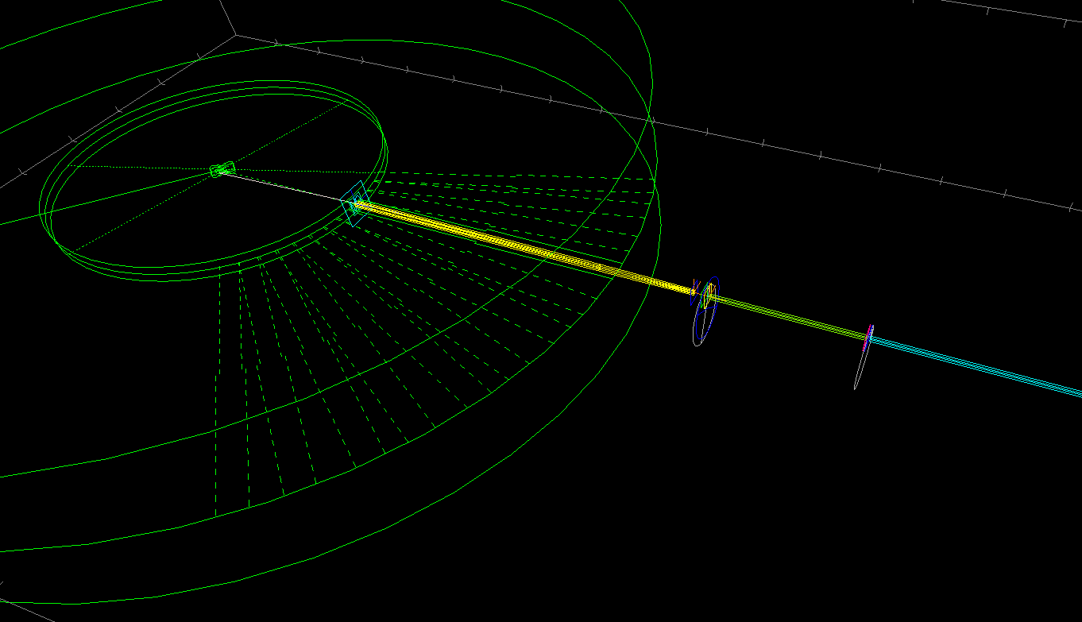
BIFROST beam
BIFROST backend
Ray tracing simulation of neutron scattering instrument including sample scattering
Write instruments in meta language built on C language
Used at nearly all neutron sources for design
Potential in data analysis and experiment planning
Great for testing data analysis procedure
BIFROST beam extraction
http://www.mcstas.org/

Slide 9
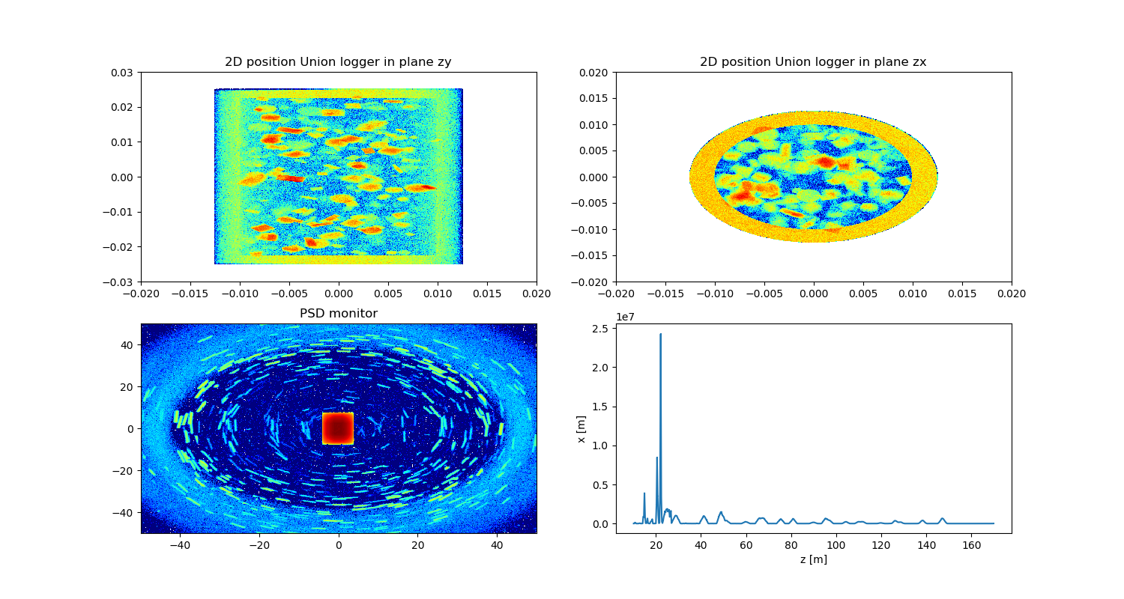
McStasScript
Syntax example
Instr = instr.McStas_instr(”demo_instrument")
source = Instr.add_component(”source”, ”Source_simple”)
source.xwidth = 0.12; source.yheight = 0.12
source.lambda0 = 5.0; source.dlambda = 3.0
sample = Instr.add_component(”sample”, ”PowderN”,
AT=[0,0,1], RELATIVE=”source”)
sample.radius = 0.01; sample.yheight = 0.03
sample.reflections = ”\”Cu.laz\””
[… add monitors …]
Data = Instr.run_full_simulation(foldername=”demo”, ncount=1E7)
Data[0].Intensity += 12.2 # Add artificial background
functions.make_sub_plot(Data) # plots the simulated data
Mads Bertelsen (ESS)
Python API for McStas
Build instrument
Run simulation
Access produced data
Plotting functionality
Developed in PaNOSC WP5
Example: Powder simulated as crystals
Scattering in sample
Intensity on detector
Sample y [m]
Detector y [cm]
Sample x [m]
Detector x [cm]

Slide 10
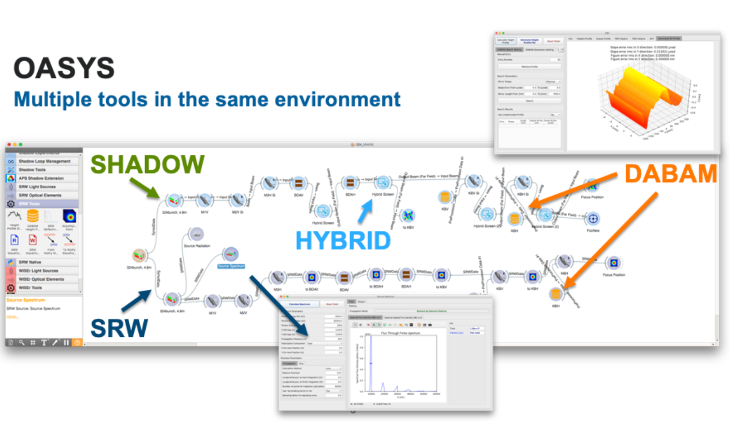
(ORange SYnchrotron Suite)
Full synchrotron radiation beamline simulations using various add-ons
Original developers: Luca Rebuffi and Manuel Sanchez Del Rio

Slide 11
OASYS development in PaNOSC
Aljosa Hafner (CERIC-ERIC)
Development of tools to unify the file formats across simulations
Remote accessibility of OASYS with examples
Development of additional add-ons:
WISEr: wavefront propagation in grazing incidence geometry
(Partial) Coherence of the X-ray beam
Computational (numerical) optimization

Slide 12
Road map
Simulation Platform
Jupyter Hub
Remote Desktop
API Layer
SimEx
McStas
OASYS
Computing Resources
Source and Beamline Simulation
Sample Trajectory Simulation
Simulation of Scattered Intensity
Data formats,
metadata standards,
FAIR principles
Photon/
Neutron database
Sample
Trajectory
Sim. Data
Catalog
Exp. Data
Catalog
Data Reduction and Analysis (WP4)

Slide 13
Where are we now - Tasks
No. | Title | Duration | Participants
T5.1 | Simulation Infrastructure | M1 – M48 | Lead: EuXFEL Contributors: ESRF, ESS, CERIC-ERIC
T5.2 | Photon and Neutron Source simulation data services (Phase I) | M1 – M24 | Lead: ESRF Contributors: XFEL.EU, ELI, CERIC-ERIC
T5.3 | Photon and Neutron beamline simulation data services (Phase II) | M13 – M36 | Lead: ILL, CERIC-ERIC Contributors: ESRF, XFEL.EU, ELI
T5.4 | Simulation of signal generation including radiation-matter interaction | M25 – M48 | Lead: ESS Contributors: ILL, XFEL.EU, ELI, CERIC-ERIC
T5.5 | Integrated simulation data workflows | M37 – M48 | Lead : EuXFEL Contributors: ESRF, ILL, ESS, CERIC-ERIC

Slide 14
Where are we now - Milestones
No. | Title | WP | Due | Verification | Status
MS5.1 | Simulation codes in PaNData Software Catalog | 5 | M6 | PaNData software catalog website | Done
MS5.2 | Demonstration of simulation services | 5 | M24 | Written report
MS5.3 | VINYL software release | 5 | M42 | Software released via open source repository
MS5.4 | Validation of simulation services | 4,5 | M48 | Written report

Slide 15
Where are we now - Deliverables
No. | Title | Due | Verification | Status
D5.1 | Prototype simulation data formats as openPMD domain specific extensions including example datasets | M12 | Written report | Draft for 1st review
D5.2 | Release of documented simulation APIs | M24 | Software | Working on
D5.3 | Repository of documented jupyter notebooks and Oasys canvases showcasing simulation tasks executable via JupyterHub or remote desktop. | M42 | Software | Start after D5.2
D5.4 | VINYL software tested, documented, and released, including integration into interactive data analysis workflow with feedback loop. | M48 | Written report + Software | Start after integration

Slide 16
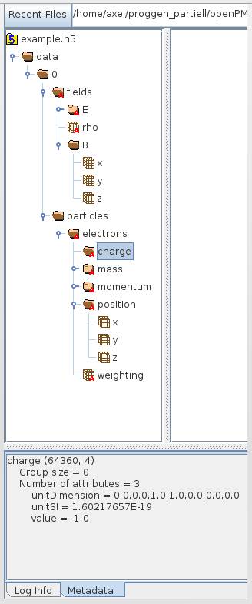

The openPMD standard
http://www.openpmd.org
Standardized hierarchical organization of (meta)data for fields and particles
Independent of file format:
hdf5 serial
hdf5 parallel
adios
netcdf
Transparent support for physical units through standardized unit conversion scheme
Application specific domain extensions:
PIC, wavefronts
Rad-Hydro
MD
QMD
[A. Huebl & M. Bussman, HZDR]
Notes:
16

Slide 17
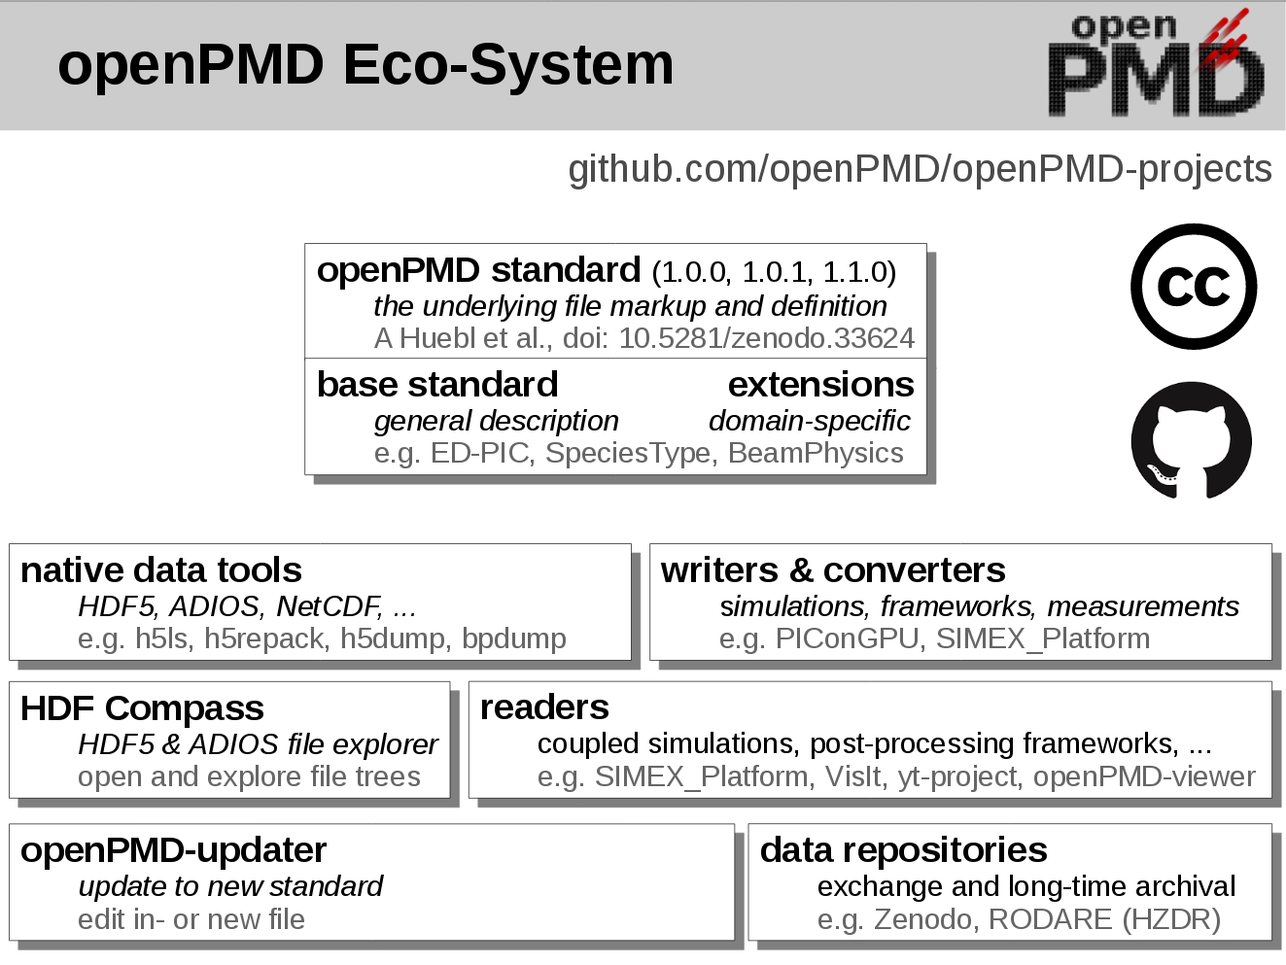
[A. Huebl & M. Bussman, HZDR]

Slide 18
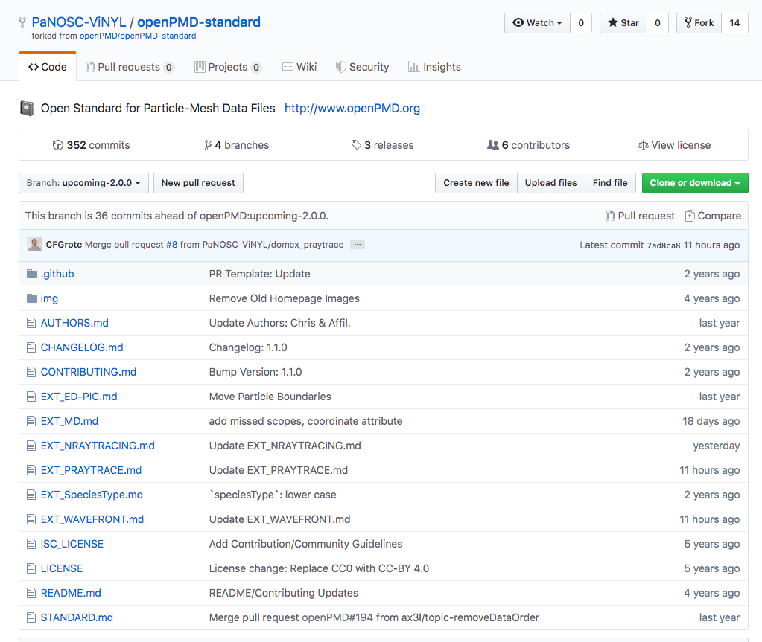
Where are we now - Deliverables
https://github.com/PaNOSC-ViNYL/openPMD-standard/tree/upcoming-2.0.0
OpenPMD domain extensions for:
Molecular Dynamics Simulation
Neutron raytracing
Photon raytracing
Coherent Wavefront Propagation
D5.1 report is on the way

Slide 19
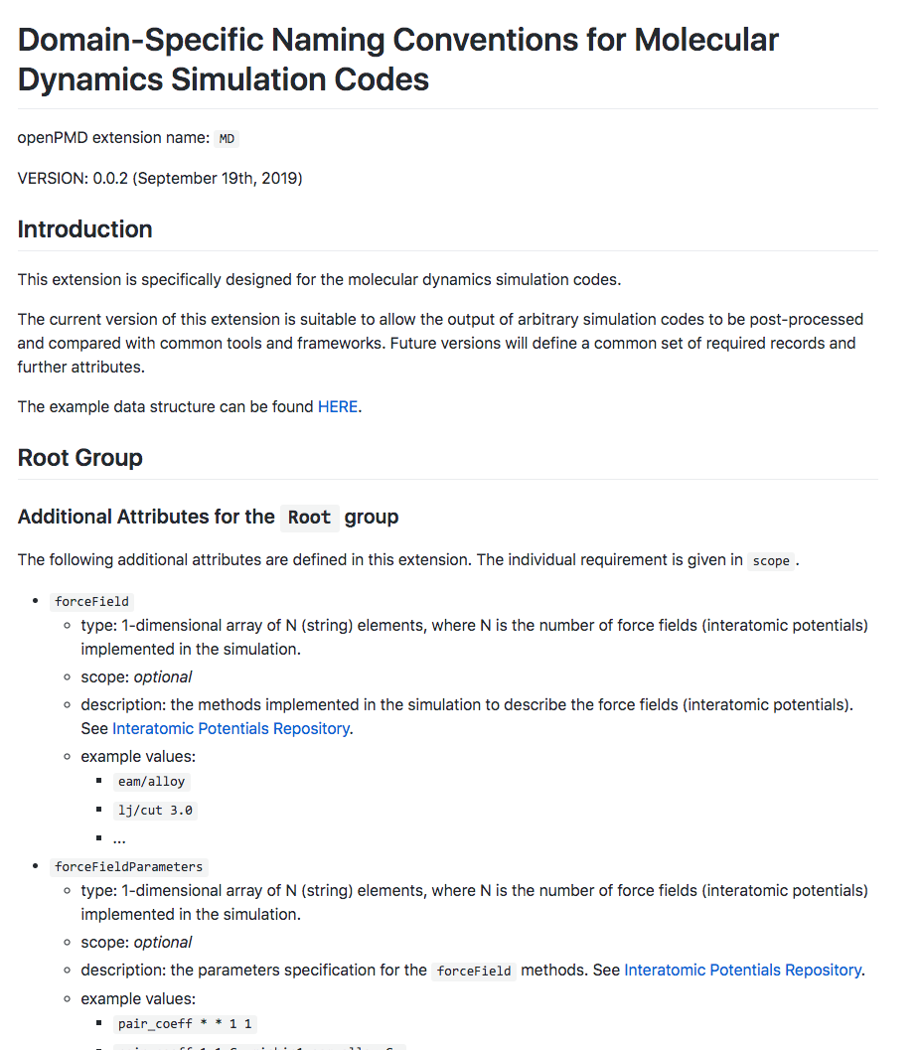
Where are we now - Deliverables
https://github.com/PaNOSC-ViNYL/openPMD-standard/tree/upcoming-2.0.0
OpenPMD domain extensions for:
Molecular Dynamics Simulation
Neutron raytracing
Photon raytracing
Coherent Wavefront Propagation
D5.1 report is on the way

Slide 20
Personnel change
Carsten Fortmann-Grote will remain 10% of his time attached to the project.
No hires yet at ESRF, ILL
Some time is needed to catch up, but we are still on track

Slide 21
Internal collaboration
With WP4: Data Analysis Services
Analyze simulation results with methods provided in WP4
Compare the simulation results with real experimental results
Weekly coordination meeting at EuXFEL
With WP8: Staff and User Training
Provide training jupyter-notebook for WP8

Slide 22
What’s next
Event:
A WP5 workshop in Hamburg, in the first quarter of 2020.
Package tasks:
Development of simulation platforms (T5.1)
User friendly
Algorithm optimization
Documentations for simulation APIs (D5.2 [Due: M24])
Simulation could service setup and integration (T5.2 [Due: M24], MS5.2 [Due: M24])

Slide 23
Thank you for your attention
* juncheng.e@xfel.eu

Slide 24
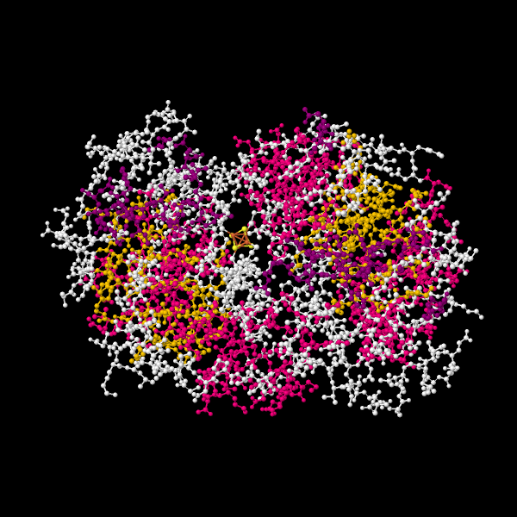
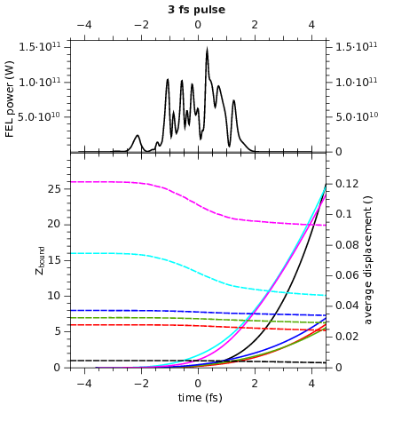
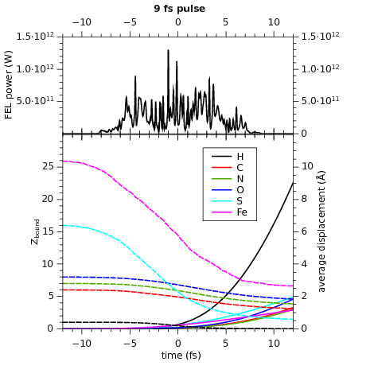
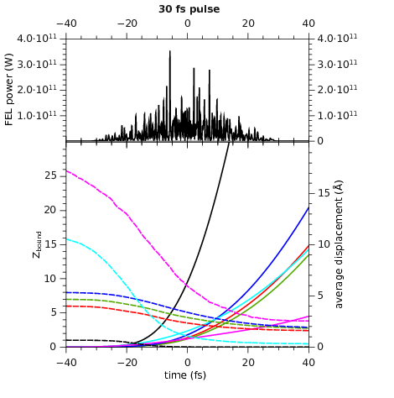
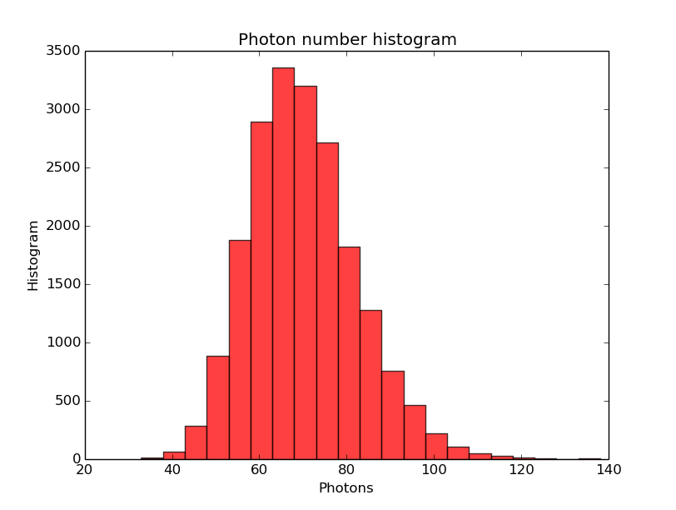
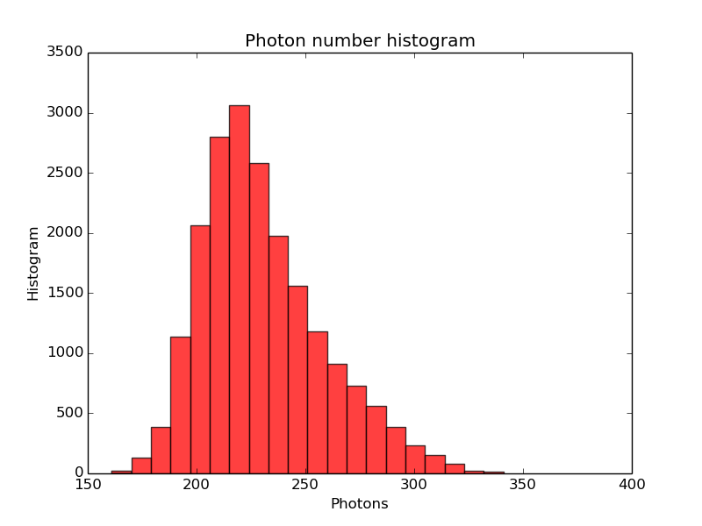
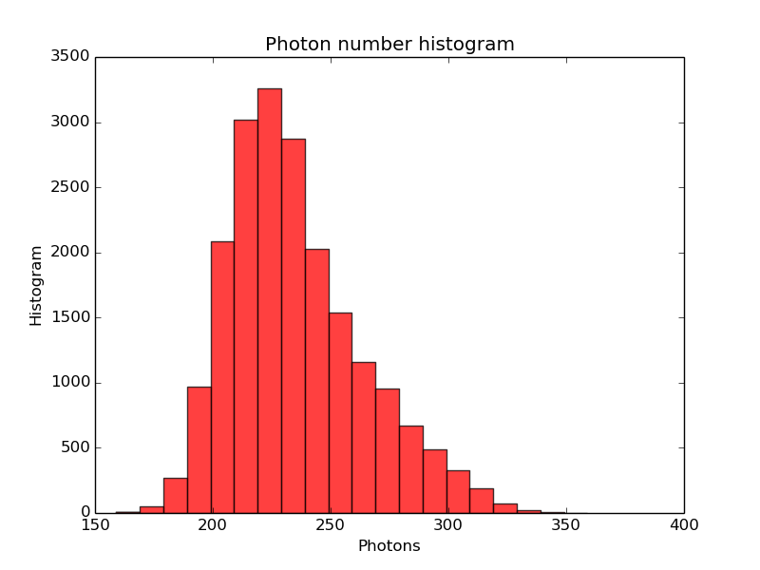
Identify optimal pulse duration for small protein imaging
photons per pulse = 1·10¹¹ 5·10¹¹ 1·10¹²
3 fs
9 fs
30 fs
FEL power (W)
sample molecule 2NIP
avg. displacement (Å)
Atom | τ_{Auger}(fs)
C | 10.7
N | 7.1
O | 4.9
S | 1.3
Fe | 2.0
# bound electrons
time (fs)
diffracted photons = 70+/-12 230+/-28 234+/-29
CFG et al., IUCrJ 4 (2017)
Yoon et al. Scientific Reports 6 24791 (2016)

Slide 25
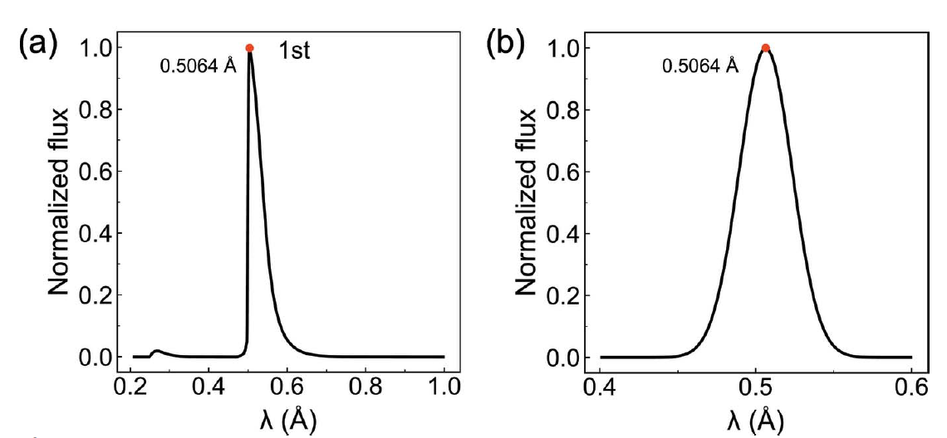
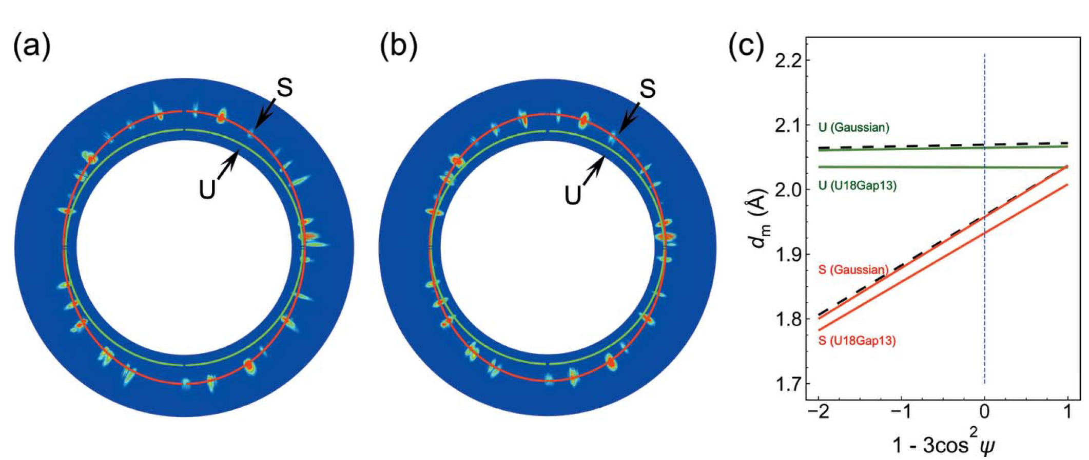

Verify analysis methodology suitability in various x-ray spectrum
Slope: strength, not affected by the spectrum width or symmetry
Intercept: density, affected by the asymmetry of the undulator x-ray spectrum
Y.Y. Zhang, M.X. Tang, Y. Cai, J.C. E, and S.N. Luo, Journal of Synchrotron Radiation 26, 413 (2019).

